Slide 1

I2P Mid2 Practice
12510 Hakka’s Maze

Slide 2

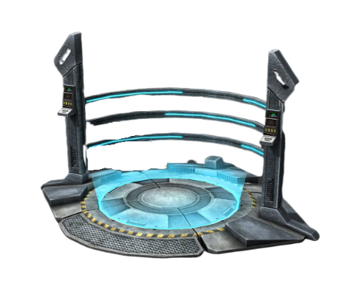
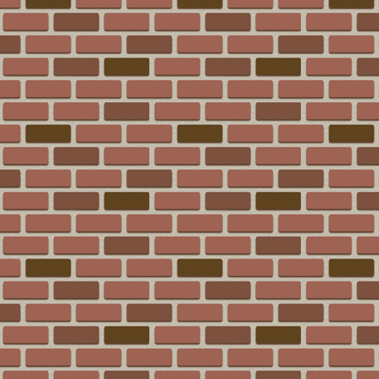

sdad
Description
 | * | *
 |  | *
Given T maps, each of which has N*M grids.
3 types of grids:
road(*), wall(#), teleport device(T)
Start: Top-left grid.
Goal: Bottom-right grid.
While standing on a road(*) or on a teleport device(T),
you can go up, down, left, right.
While standing on a teleport device(T),
you can also go to every other teleport device.
You cannot stand on a wall(#).

Slide 3
Sample
Input
3
3 3
***
**#
*#*
3 3
***
***
***
2 2
T#
#T
Output
No
Yes
Yes
First line of input: Three maps.
First map:
The right-bottom corner is blocked by two walls.
-> No
Second map:
There exists an L-shaped path to the goal.
-> Yes
Third map:
You can teleport from the start to the goal.
-> Yes

Slide 4
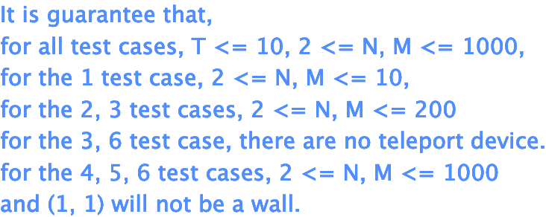
Range

Slide 5
First attempt
In this case, we ignore the teleport devices’ teleport property.
We simply walk until we have no more available options.
How to implement?
-> Using recursion.
Every grid has at most four options (up, down, left, right).
Call recursion on every available option (Not a wall & In the map).
We return on finish exploring every option of a grid.

Slide 6
Depth-First Search (DFS)
(0, 0)
Map/vis <record>
down
* | * | * | # | #
* | * | # | # | #
# | * | * | # | *
* | # | # | * | *
(1, 0)
right
(1, 1)
down
up
(2, 1)
(0, 1)
right
right
(2, 2)
(0, 2)

Slide 7
Code: DFS (No Teleports)
bool vis[1010][1010]; //2D array for recording visited grids
void dfs(int x, int y) {
if (vis[x][y]) // This grid is explored
return;
vis[x][y] = true; // Record the current grid as visited
int dx[] = {1, -1, 0, 0};
int dy[] = {0, 0, 1, -1};
for (int i = 0; i < 4; i++) { // Try four directions
int newx = x + dx[i]; // The next choice
int newy = y + dy[i];
if (newx < 0 || newy < 0 || newx >= n || newy >= m) // Out of boundary
continue;
if (s[newx][newy] == ‘#’) // The choice is a wall
continue;
dfs(newx, newy); // Recurse to next choice
}
}

Slide 8
Teleport Devices
 | * | *
 |  | *
How about the teleport devices ?
Method1:
Loop through every device while standing on a device.
-> The maximum number of devices is N * M = 10^6.
-> We need at most (10^6)*(10^6) = 10^12 operations.
-> Computer can only handle 10^8~10^9 operations in 1 second.
-> May cause TLE.
Method2:
If we note that we can reach a device during the above DFS (ignoring teleport devices), use the devices as new starting points to do additional DFS.
-> We use the flag variable “can_teleport” for this purpose.

Slide 9
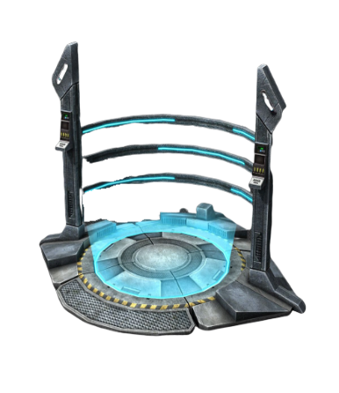

Teleport
can_teleport: 1
Since we reached a device in the first DFS, we use every device as a new starting point.
Map/vis <record>
* | * |  | # | #
* | * | # | # | #
# | * |  | #
* | # | # | * | *
visited
(2, 4)
(0, 2)
(2, 2)
down
(3, 4)
left
(3, 3)

Slide 10
Code: DFS + Teleport
bool vis[1010][1010]; //2D array for recording visited grids
bool can_teleport; // Set as true if we can reach a teleport device
void dfs(int x, int y) {
if (vis[x][y]) // This grid is explored
return;
if (s[x][y] == 'T’) // Reach a teleport
can_teleport = true;
vis[x][y] = true; // Record the current grid as visited
int dx[] = {1, -1, 0, 0};
int dy[] = {0, 0, 1, -1};
for (int i = 0; i < 4; i++) { // Try four directions
int newx = x + dx[i]; // The next choice
int newy = y + dy[i];
if (newx < 0 || newy < 0 || newx >= n || newy >= m) // Out of boundary
continue;
if (s[newx][newy] == ‘#’) // The choice is a wall
continue;
dfs(newx, newy); // Recurse to next choice
}
}

Slide 11
Code: Main
int main() {
int T; // Number of maps
scanf("%d", &T);
while (T--) {
scanf("%d%d", &n, &m); // Read rows and columns
for (int i = 0; i < n; i++) // Scan the map
scanf("%s", s[i]);
memset(vis, false, sizeof(vis)); // Initialize the vis[][] array
can_teleport = false; // Initialize the can_teleport flag
dfs(0, 0); // Do DFS the first time
if (can_teleport) { // Reached a device at the first DFS
for (int i = 0; i < n; i++)
for (int j = 0; j < m; j++)
if (s[i][j] == 'T’)
dfs(i, j); // Use the teleport device as a new starting point
}
if (vis[n - 1][m - 1]) printf("Yes\n"); // We reached the goal
else printf("No\n"); // Failed to reach the goal
}
return 0;}

